Slide 1

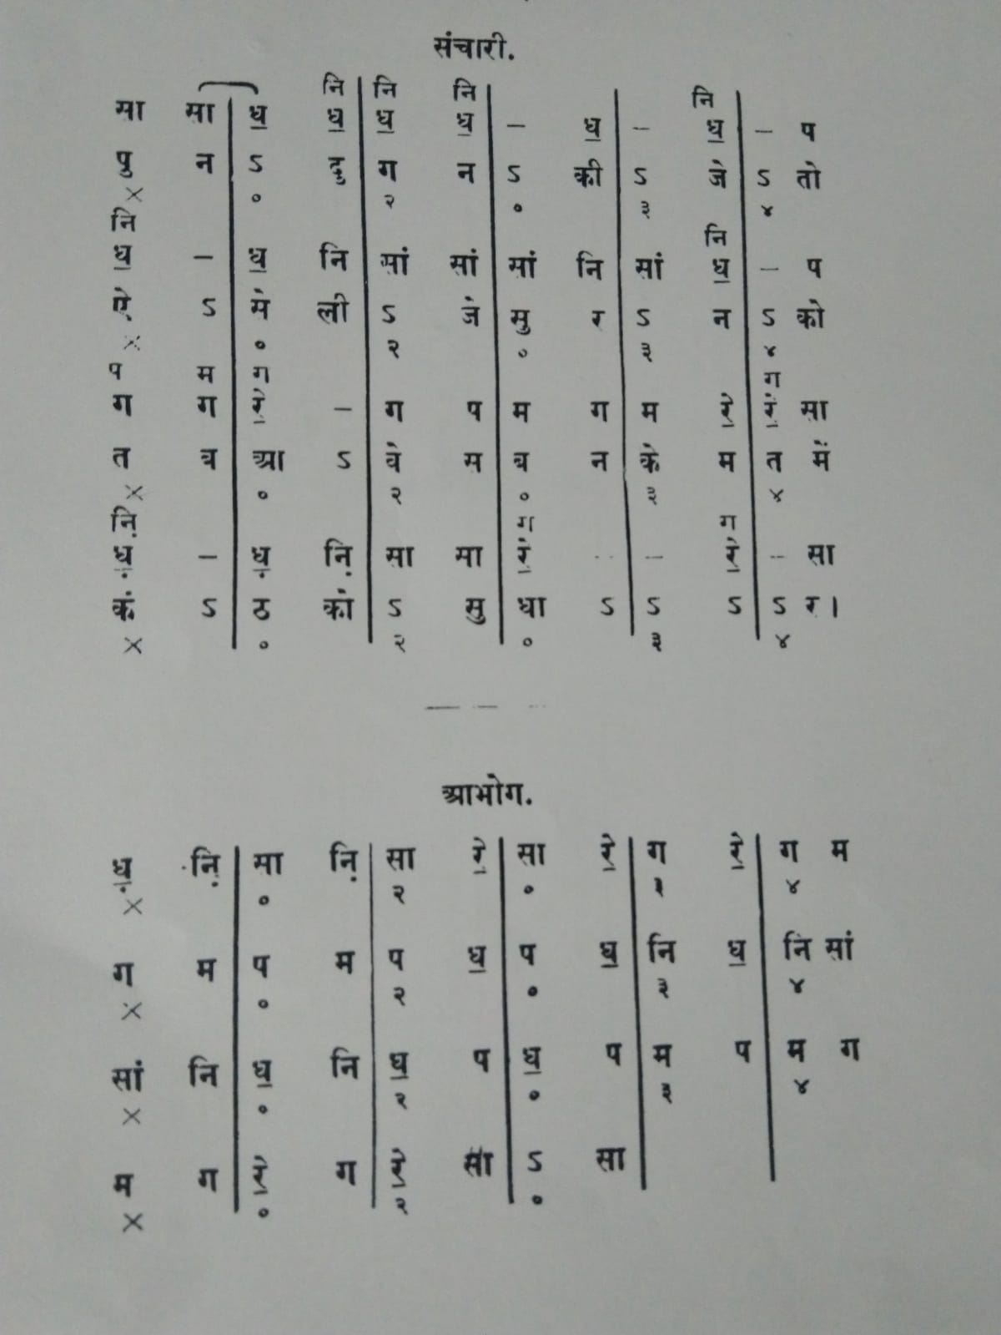
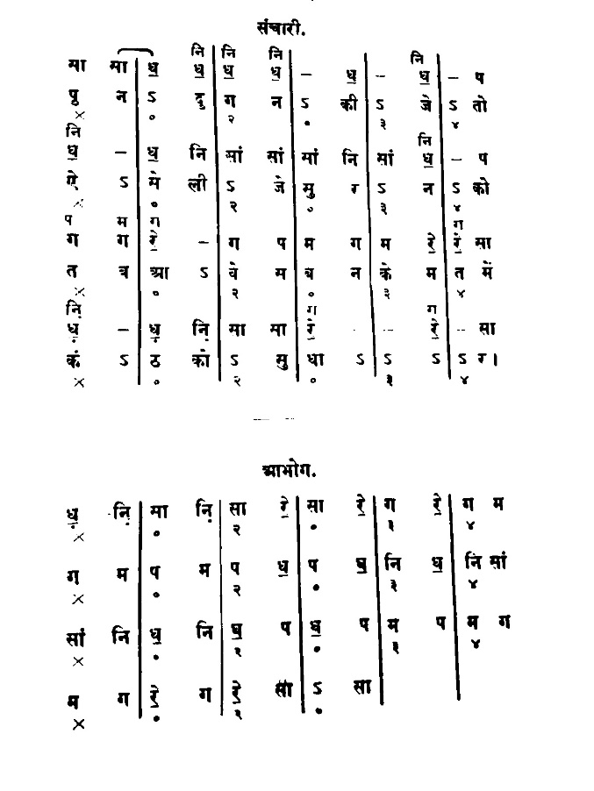
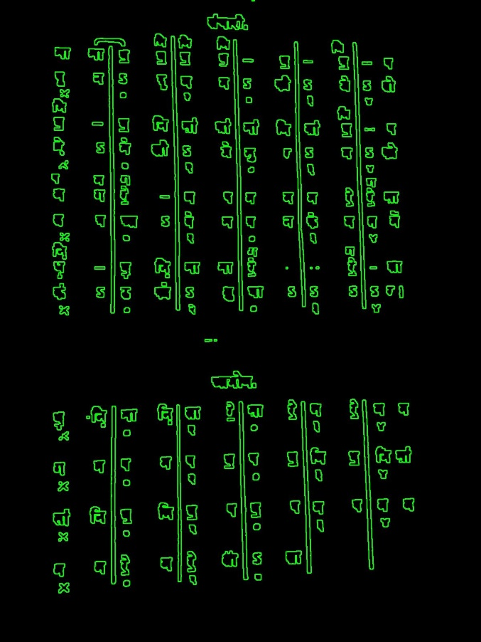
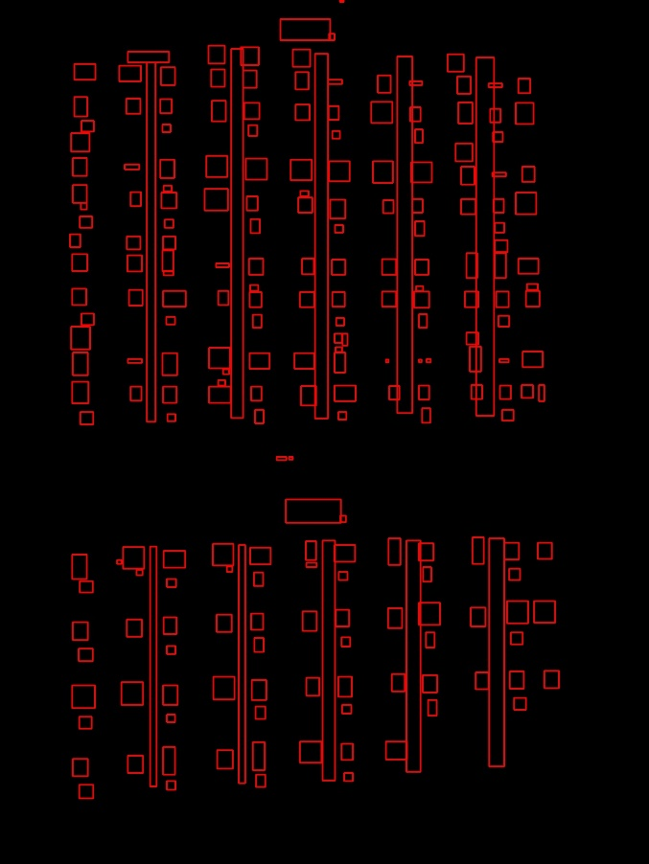
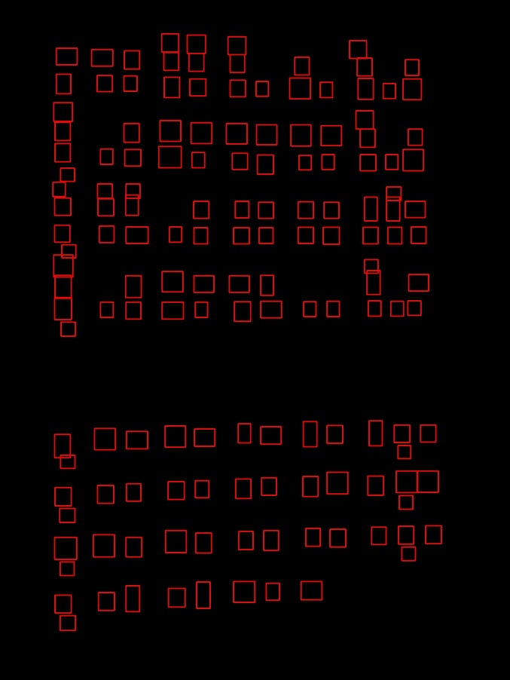
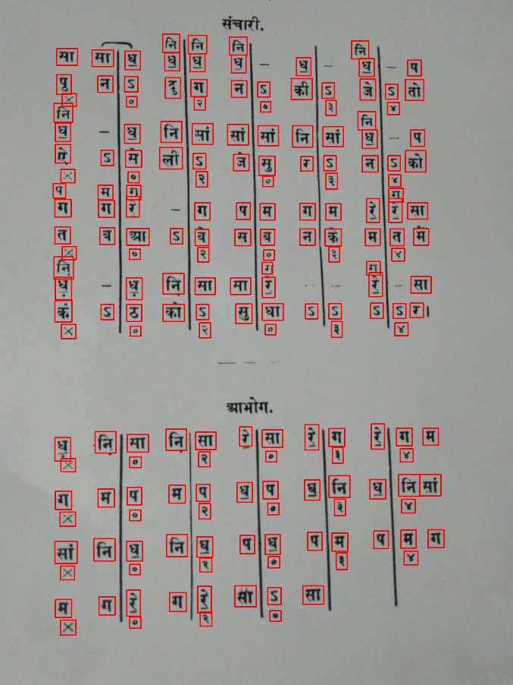




Extraction of melodies with pitch classes from images of HCM compositions in Bhatkhande notation
Conversion of Music Notes from images of Bhatkhande Notation System into MIDI file(audio file) involving Images Processing using OpenCV, Deep convolutional neural network modeling using Tensorflow and Keras and extracting those notes to be converted into a playable audio file using music21 toolkit for computer-aided musicology.
Text Extraction
Text Classification
Audio Conversion
1. Binary converted
2. Contours drawn
3. Bounding Rectangles
4. Filtered Rectangles
5. Extracting Notes
Rescaling (32 X 32)
Scaling (0->255)
Grayscaling
MIDI
File
-> We receive:
Deep CNN Model
music21

